Slide 1
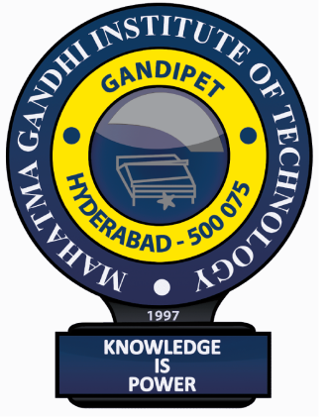
An Industry Oriented Mini Project (CS705PC)
on
HandWritten Mathematical Equation Solver
by
Kore Shivamani
Under the Guidance of
Dr. B. Yadaiah
(Asst. Professor)
Department of Emerging Technologies
MAHATMA GANDHI INSTITUTE OF TECHNOLOGY
2024 – 2025

Slide 2
Abstract
This project presents the development of a handwritten mathematical equation solver, aimed at automating the interpretation and solution of handwritten mathematical expressions. The system combines cutting-edge image processing techniques with advanced machine learning models, including CNN and RNN, to accurately recognize and digitize handwritten equations. Following recognition, the equations are processed using symbolic computation methods to solve them. The solver addresses several challenges inherent in handwritten recognition, such as diverse handwriting styles, variations in symbol representation, and the presence of noise. Through rigorous evaluation on diverse datasets, including both simple and complex equations, the system demonstrates high accuracy and robustness. Performance metrics are analyzed to ensure the solver's reliability in practical scenarios, with a focus on its application in educational settings and research. Future enhancements will target improving recognition of complex symbols and adapting the system to handle more personalized handwriting variations, further broadening its utility and effectiveness

Slide 3
Introduction
The Handwritten Mathematical Equation Solver project aims to develop a system that automatically recognizes and solves mathematical equations written by hand. With the advancement of technology, the ability to efficiently convert handwritten content into digital form has gained immense importance in fields such as education, research, and engineering. Traditionally, solving handwritten equations required manual input into software tools, which can be time-consuming and prone to errors, especially when dealing with complex mathematical expressions. This project proposes a solution to bridge the gap between handwritten input and digital computation.
The system leverages advanced techniques in image processing, optical character recognition (OCR), and machine learning to recognize handwritten mathematical symbols and equations. Once the system interprets the handwritten content, it translates the input into a digital format that can be further processed to solve the equation. This will provide users with both the interpretation and the solution, making it highly useful for students, educators, and professionals dealing with mathematics.
The goal of this project is to build a user-friendly interface that allows users to either draw or upload an image of a handwritten equation, have the system recognize it, and return the solved output efficiently. This will enhance productivity, reduce manual effort, and make the learning process more interactive and accessible.

Slide 4
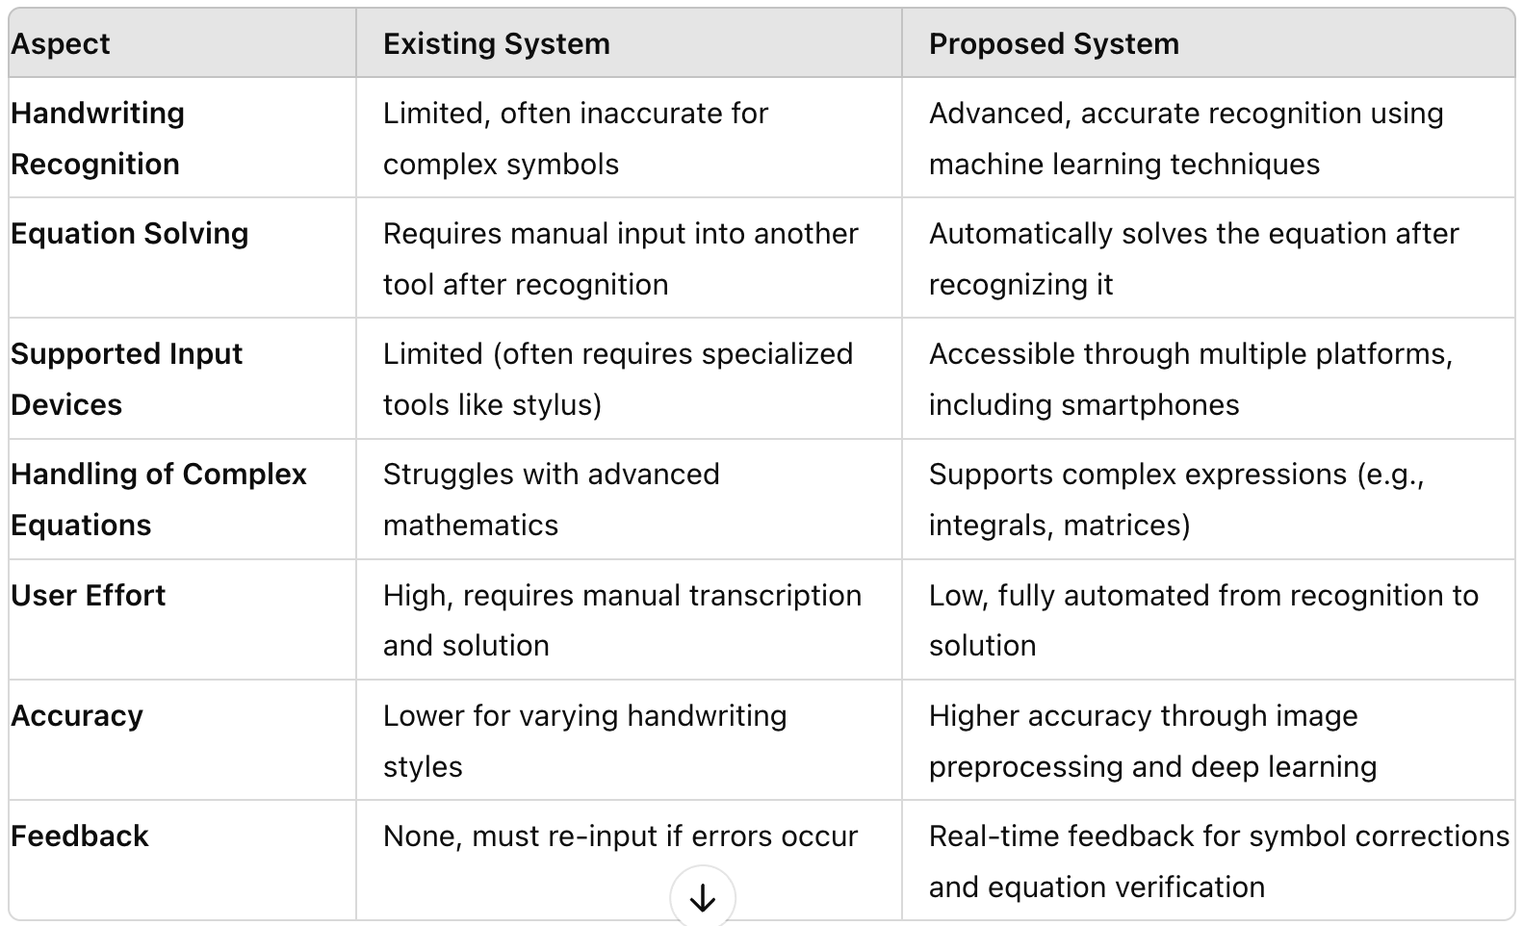
Existing System Vs Proposed System

Slide 5
Technical Specification
Software Requirements
Operating System: Windows 7 or Windows 10 or MAC
Tool: Google Colab Virtual Python Runtime
Hardware Requirements
Processor: Intel i3 or more(more than 2GHz)
RAM: 4GB or more
Hard Disk: 80 GB

Slide 6
Conclusion
This project demonstrates the remarkable capabilities of convolutional neural networks in the domain of handwritten mathematical expression recognition. Through a combination of image preprocessing techniques and a carefully designed CNN architecture, the system successfully extracts equations from user-provided images. The extracted equations are then transformed into machine-readable formats that allow for computational solutions. This ability to bridge the gap between handwritten and digital mathematics has a wide range of real-world applications. Within educational settings, it can empower students by automating the process of verifying calculations and providing step-by-step guidance for solving problems. Furthermore, it holds great potential for enhancing accessibility tools, allowing those with visual impairments or learning differences to easily engage with mathematical content in a digital environment.

Slide 7
Bibliography
[1] Shinde, Rajwardhan, Onkar Dherange, Rahul Gavhane, Hemant Koul, and Nilam Patil."Handwritten Mathematical Equation Solver." International Journal of Engineering Applied Sciences and Technology (IJEAST) ,(2022)
[2] Hossain, Md Bipul, Feroza Naznin, Y. A. Joarder, Md Zahidul Islam, and Md Jashim Uddin. "Recognition and solution for handwritten equation using convolutional neural network." In 2018 Joint 7th International Conference on Informatics, Electronics & Vision (ICIEV) and 2018 2nd International Conference on Imaging, Vision & Pattern Recognition (icIVPR), pp. 250-255. IEEE, 2018.
[3] Liu, Wenfei, Jingcheng Wei, and Qingmin Meng. "Comparisions on KNN, SVM, BP and the CNN for Handwritten Digit Recognition." In 2020 IEEE International Conference on Advances in Electrical Engineering and Computer Applications (AEECA), pp. 587-590. IEEE, 2020.

